Slide 1
Certificate Troubleshooting using AirWatch
TEIS Digital Workplace
Document Version 1.1

Slide 2
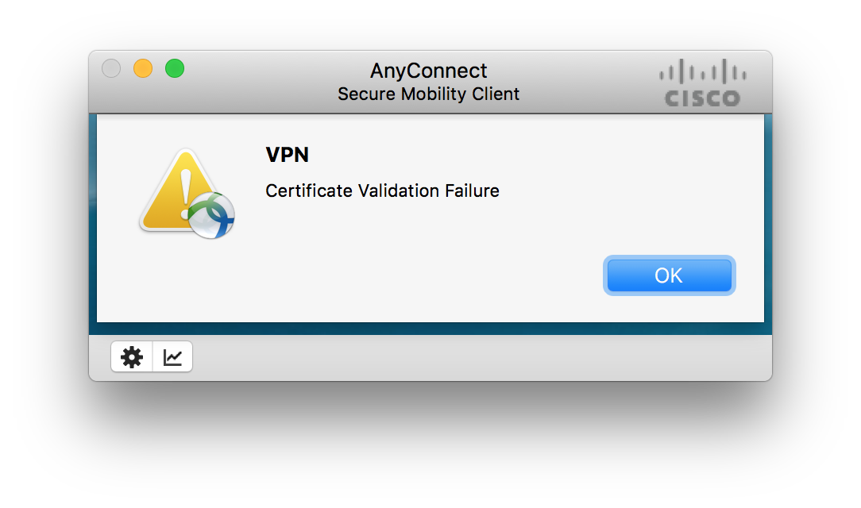
Issue Verification
AnyConnect refuses to establish a VPN connection, reporting a “Certificate Validcation Error”.

Slide 3
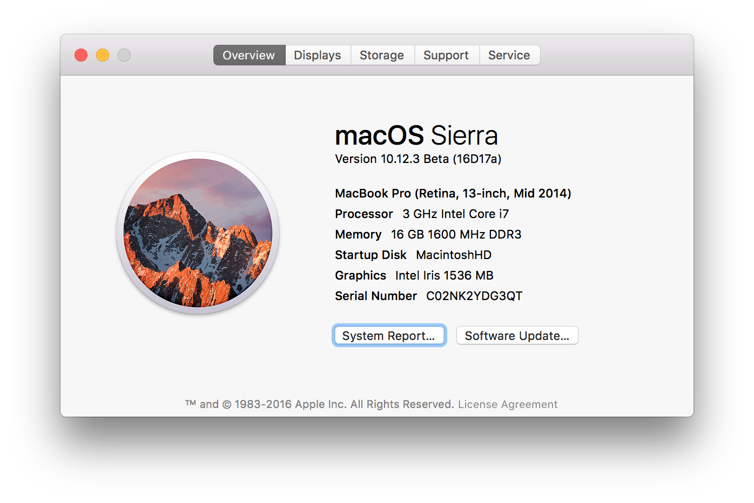
OS Version
This troubleshooting is only valid on macOS Sierra devices, that are enrolled in AirWatch.
Begin by verifying the OS using the “About this Mac” option from the Apple menu. You are looking for a version number of 10.12.0 or higher.

Slide 4
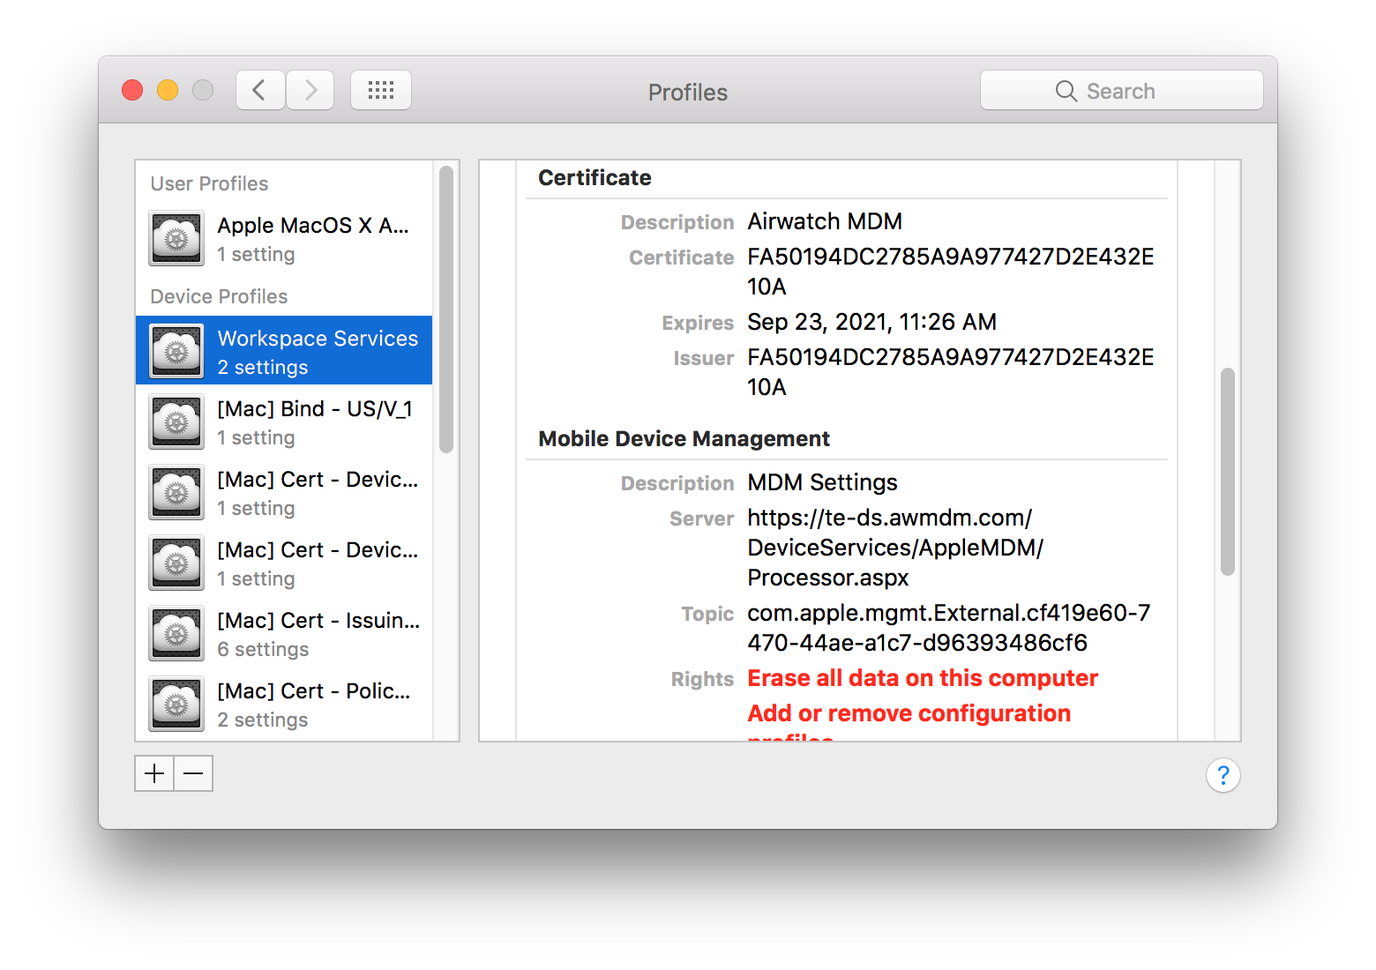
Management Profiles
This troubleshooting is only valid on macOS Sierra devices, that are enrolled in AirWatch. Verify that the device is enrolled by checking the Profiles pane of System Preferences for the “Workspace Services” profile. Scroll down and verify that the ”Server” field is set to some variation of: https://te-ds.awmdm.com

Slide 5
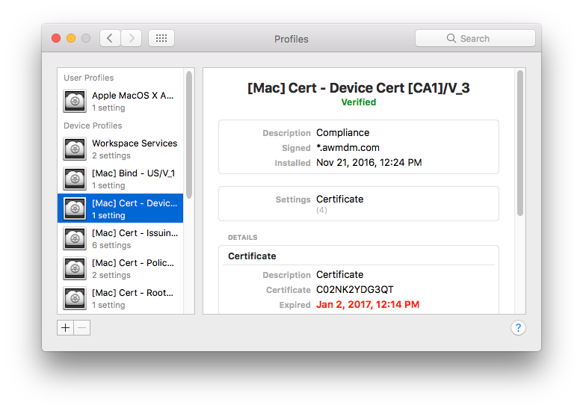
Check for Cert Profile
While in the Profiles pane of System Preferences, also verify that the “Device Cert” profile is present.
In cases of an expired certificate, the expiration date will be listed in the profile.

Slide 6
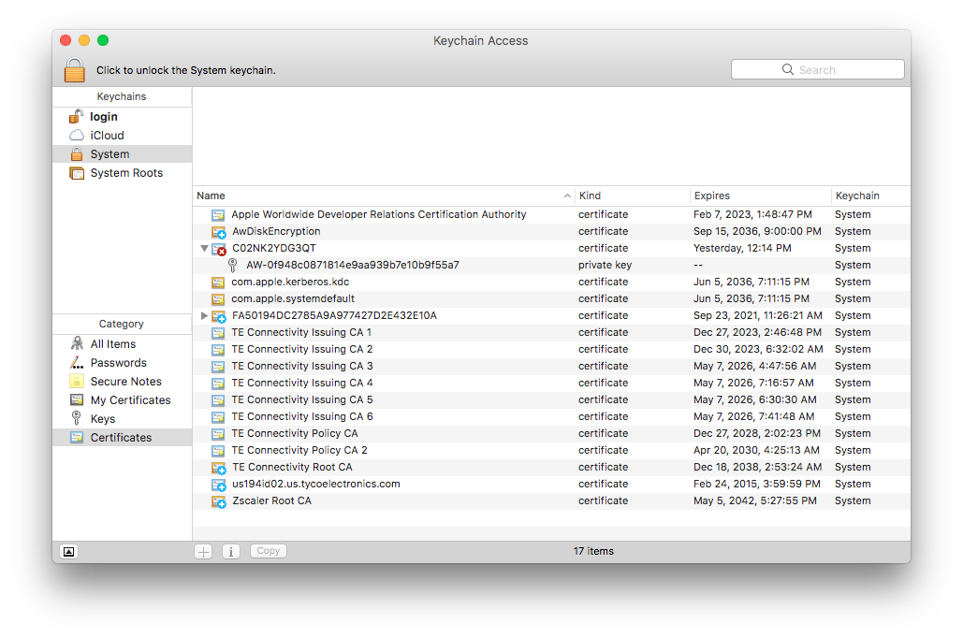
Keychain Verification
Additionally, in cases of expired certificates, the previous certificate should be visible in Keychain Access.
Launch Keychain Access from the Utilities folder, then select “System” from the ”Keychains” section, and “Certificates” from the “Category” section. The list on the right should then include a certificate named for the serial number of the device. Clicking the disclosure triangle should reveal a private key named “AW-” followed by a long hexadecimal string.

Slide 7
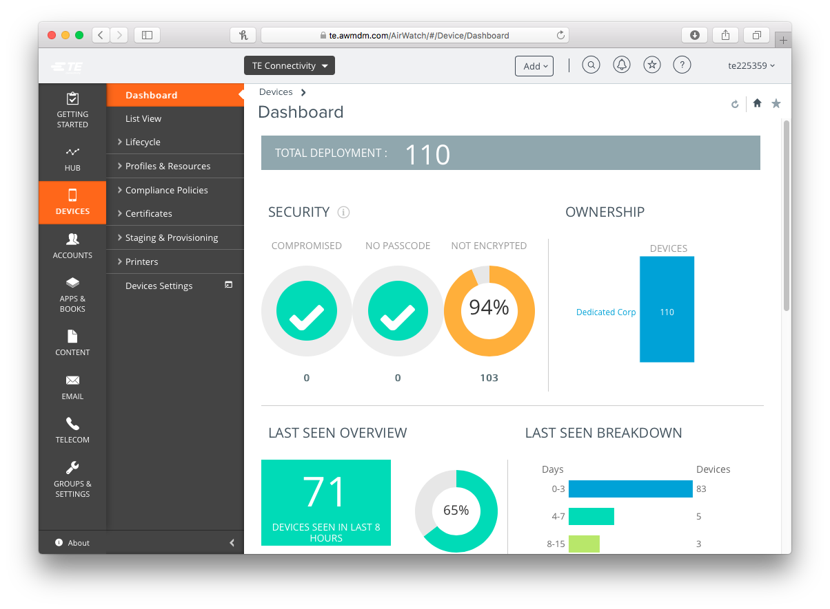
AirWatch Admin Console
Navigate to go/AirWatch and login using your network credentials (NOT your ADM account).

Slide 8
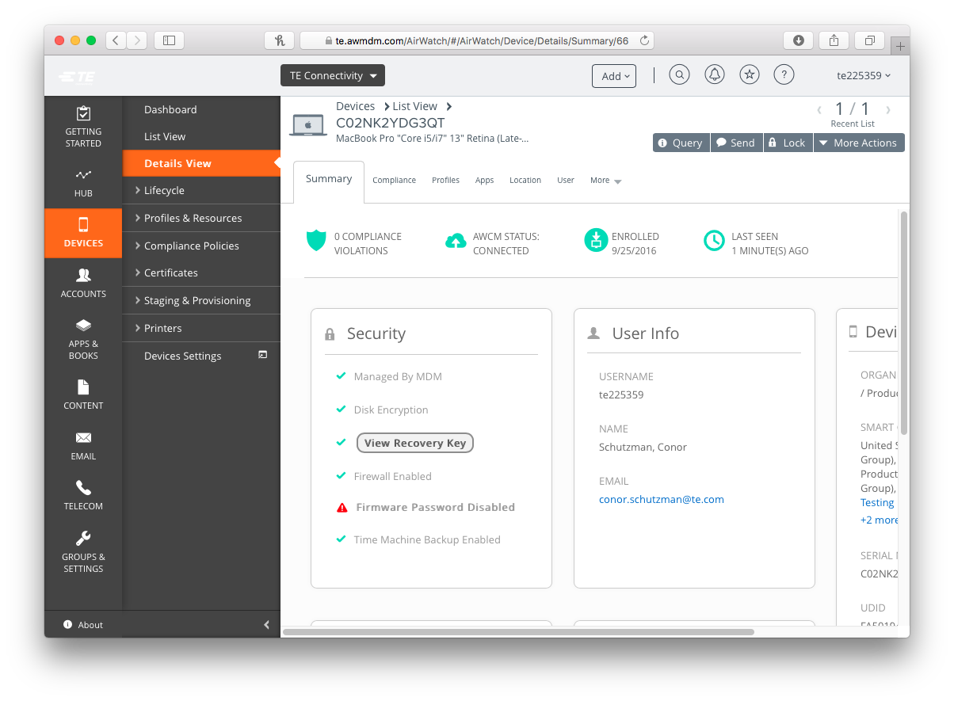
AirWatch Device Record
From the list on the left, select “Devices”, then select “List View” from the sub menu. In the list that appears, search for the serial number of the device (you can also search by the network ID of the primary user of the device). Clicking on the entry in the list will bring up a detailed view.

Slide 9
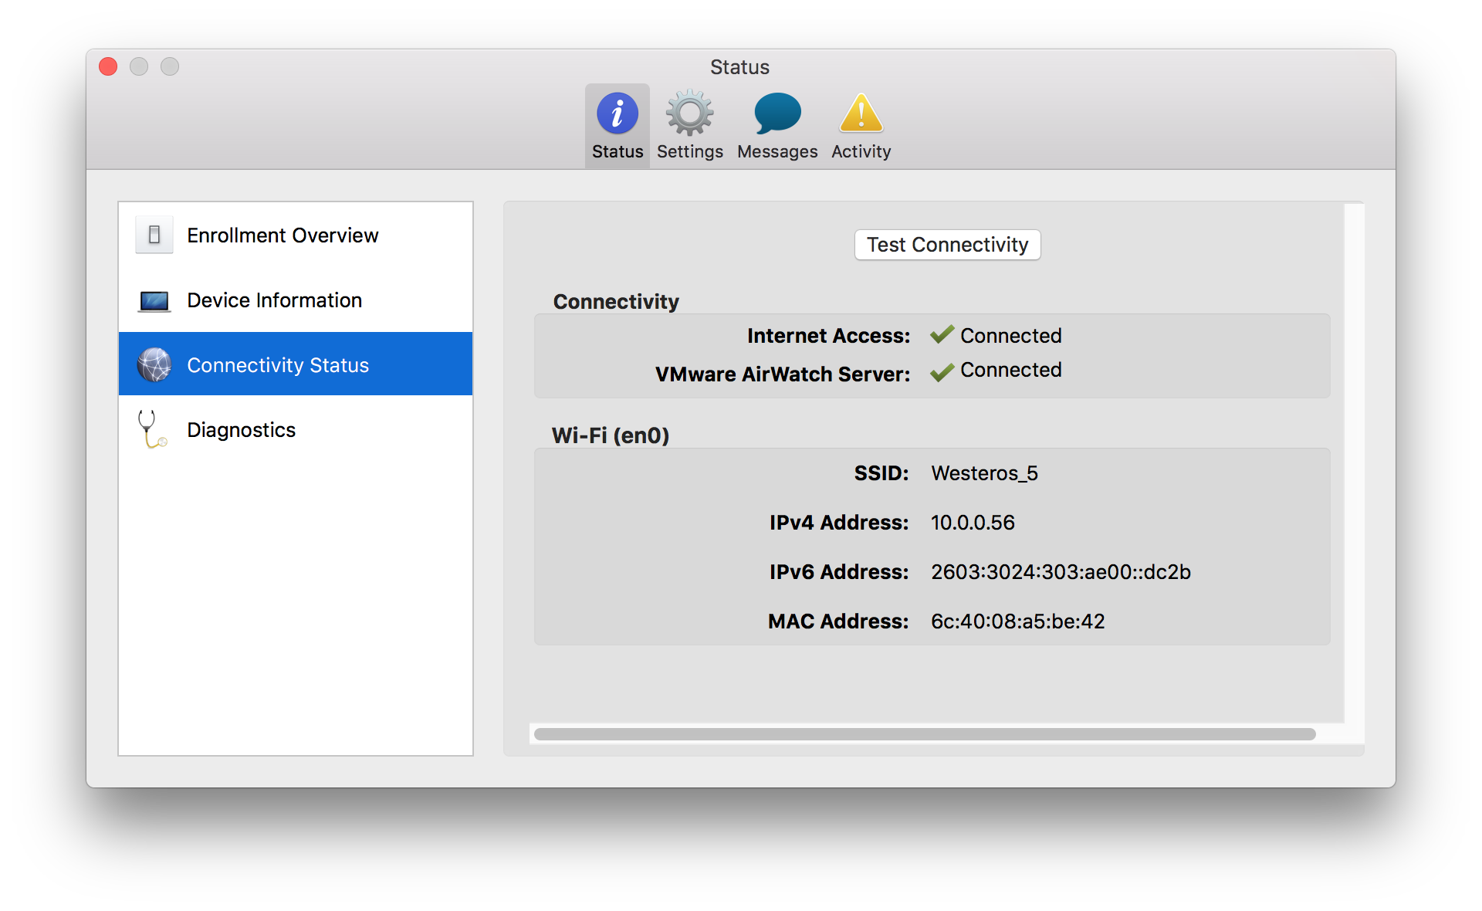
Connection Verification
At the top of the details view, take note of the “AWCM Status” and “Last Seen” fields, as they will provide information about how well the device is communicating with the server.
On the client side, you can use the “Preferences” entry of the AirWatch menu item to verify connectivity.

Slide 10
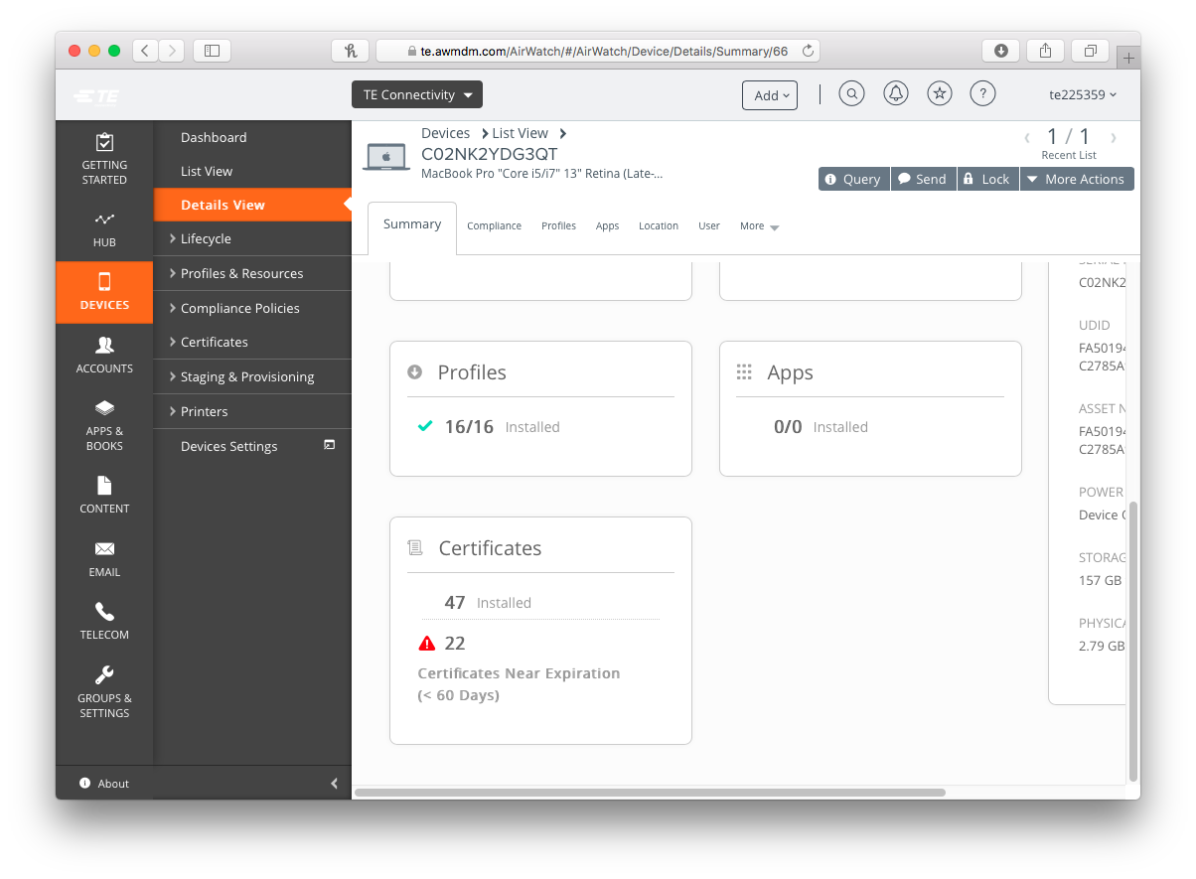
Details View
Further down the initial details screen on the Admin Console, note the “Profiles” and “Certificates” listing. Clicking on either of these category headings will show you detailed information on those specific facets of the device.

Slide 11
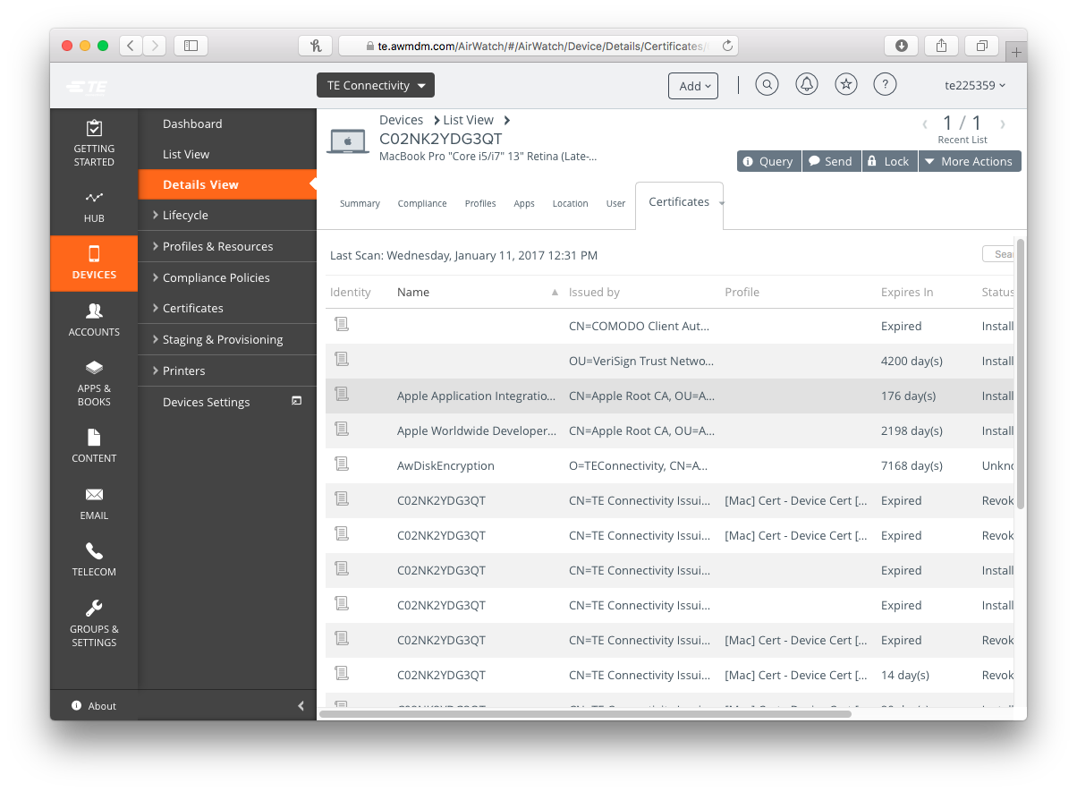
Certificate Details
Clicking on the Certificates heading will display the current certificates on the device.
In the case of an expired certificate, there will be an entry in this list, named with just the device serial number, that lists as ”Expired” with a status of either “Installed” or “Revoked”

Slide 12
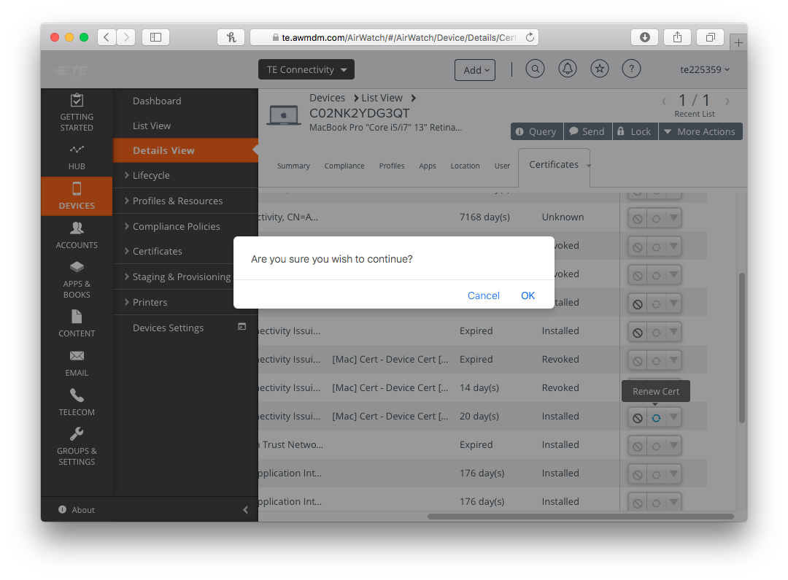
Manual Renewal
In some cases, there will be a circular arrow icon that will allow you to manually request a renewal of the expired certificate.
You will be prompted to confirm this action.
After issuing the renewal, the “Query” button at the top of the panel (or having the client use “Sync Now” from the AirWatch menu icon), followed by refreshing the page, should show a new certificate with a 42 day expiration.

Slide 13
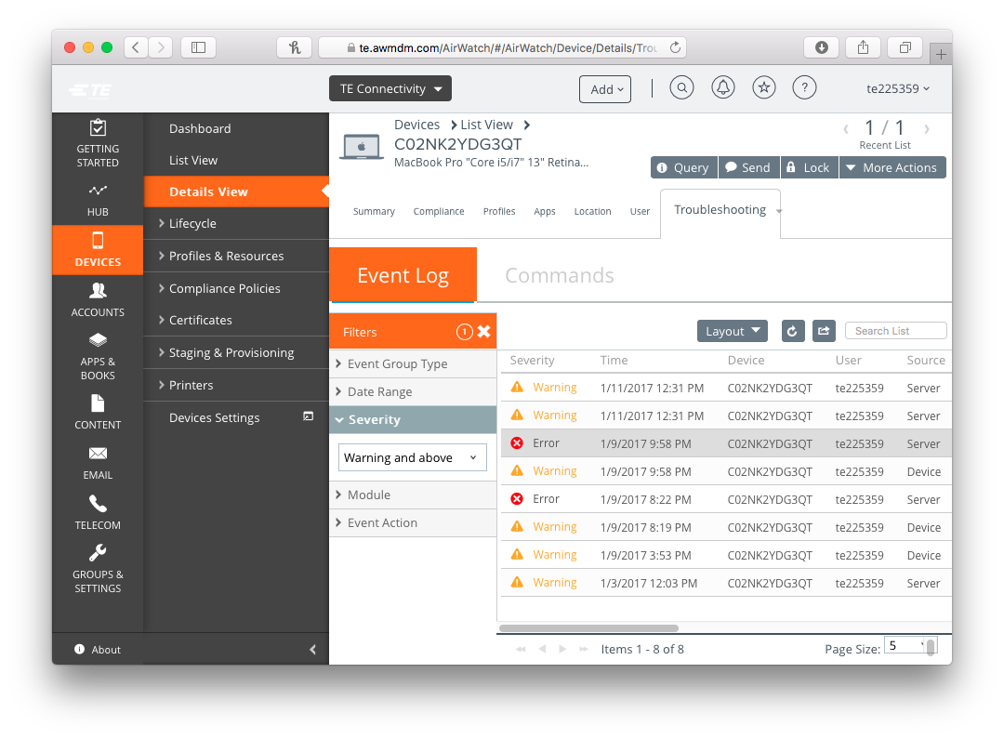
Failed Renewals
If, after querying and refreshing, perhaps waiting and retrying, a new certificate is not being issued, you may need to confirm if there was an issue with the renewal.
From the right most tab (defaults to “More”) of the details view, select “Troubleshooting” from the drop down. Use the filters menu to search for any “warning” or “error” messages. The timestamps will help you confirm that these are in response to the request you just made. Please note any errors in the case notes.

Slide 14
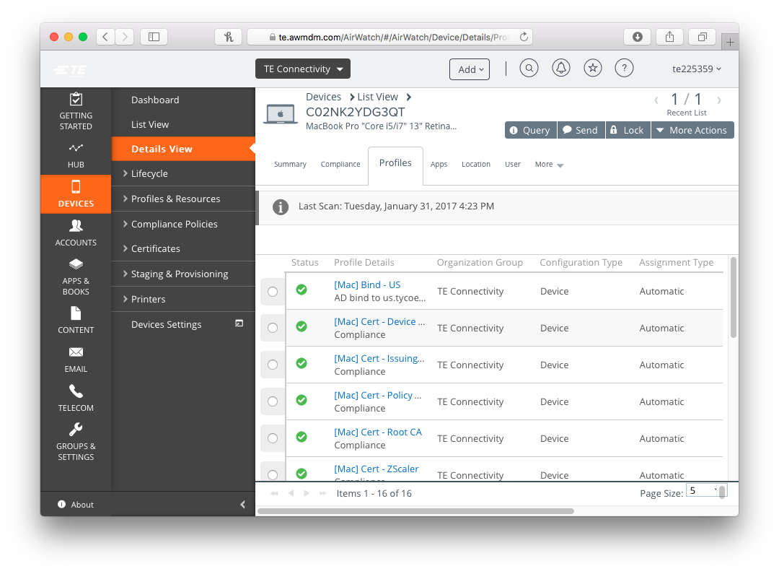
Profile Details
As the certificates are governed by the installation of profiles, it is important to verify that the relevant profile is also installed. You can either select “Profiles” from the drop down on the right most tab in the details view, or click on the “Profiles” category heading towards the bottom of the summary tab.
Note any profiles that do not have a green checkmark. It may be worth attempting to re-push any missing profiles.

Slide 15
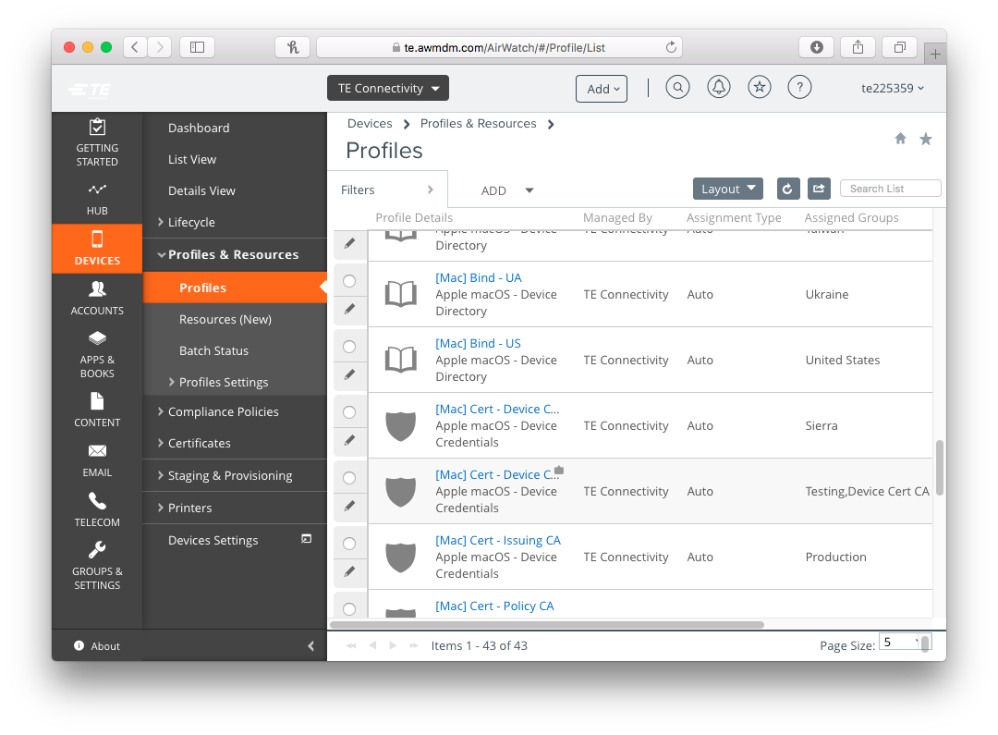
Alternative Certificates
If the default Certificate Authority (CA 1) is not issuing a valid certificate to the device, our one remaining troubleshooting step is to assign the device to get it’s device certificate from our secondary server (CA 4). The following steps will outline this process.
All profiles, and their current assignments can be viewed by selecting the “List View” from the “Profiles” section of the Devices menu in the AirWatch console.

Slide 16
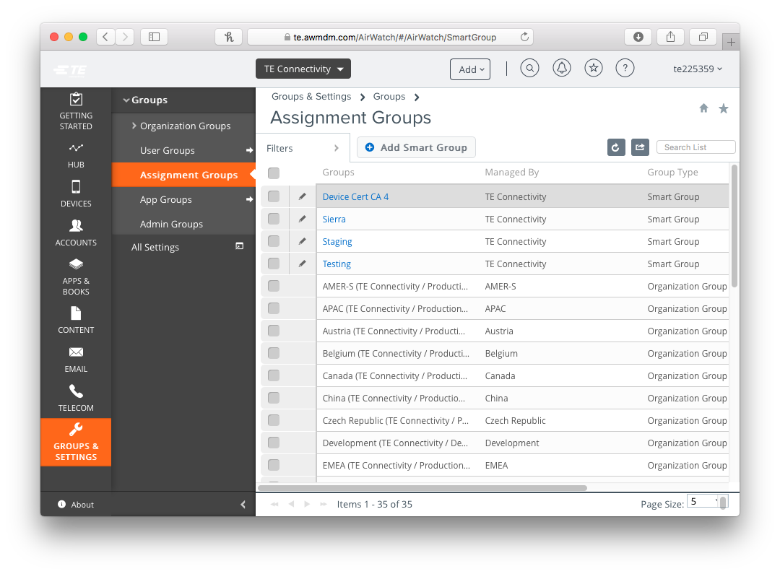
Assignment Groups
To assign the device to get a certificate from the secondary server, you will need to manually add it to a custom group within AirWatch.
Select the “Groups and Settings” icon from the bottom of the lar left menu, then “Assignment Groups” from the sub menu.

Slide 17
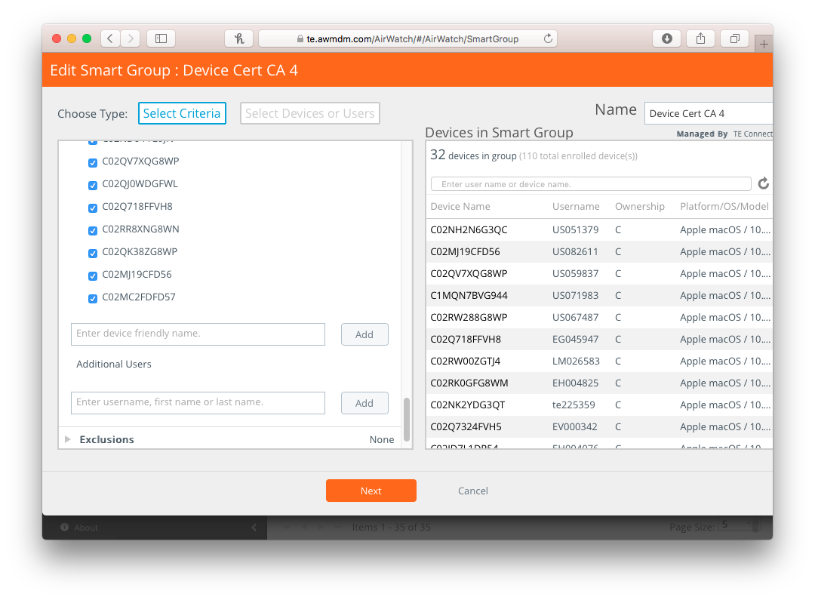
Editing the CA 4 Group
From the Assignment Groups screen, click in little pencil icon next to “Device Cert CA 4”. A list of criteria for group membership will appear. Scroll down to the bottom and expand the “Additions” section. Enter the serial number of the affected device in the field provided, it should return a list of search results (likely a single entry), select that result, and click the Add button.
The device should be added to the list on the right that shows the current members of that group.
Click Next.

Slide 18
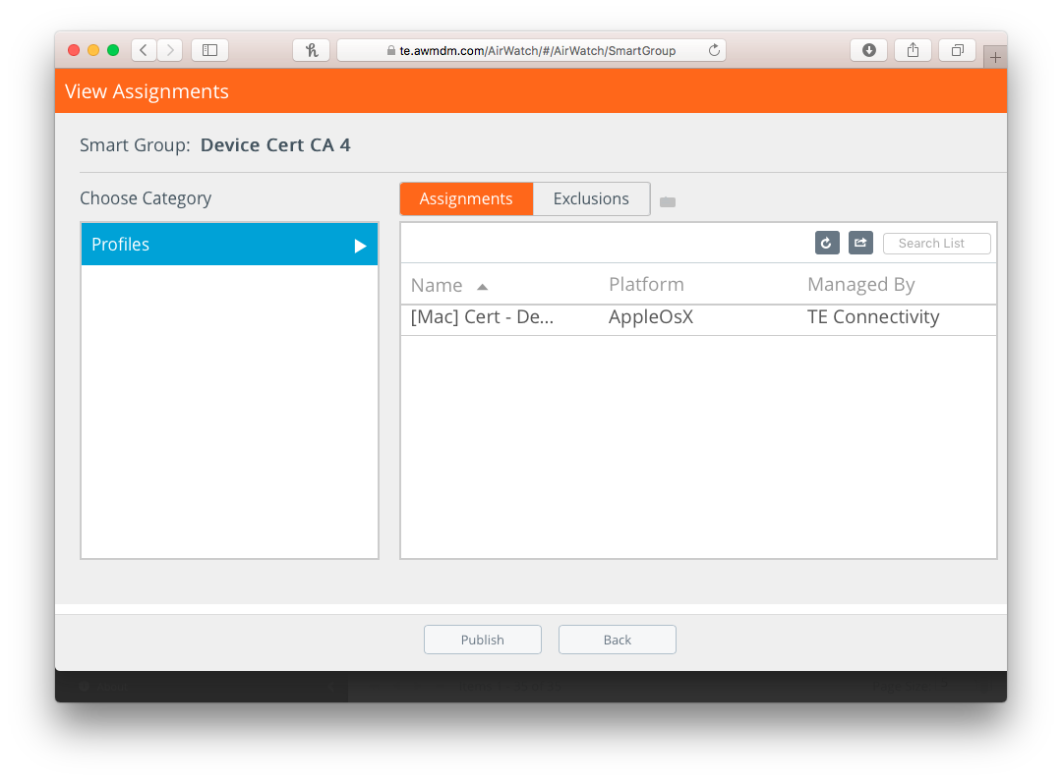
Confirmation Screen
You will then be presented with a screen that shows the profiles that have been modified by this change in group membership, and will be sent to the device you added.
Click “Publish” to confirm this change and push the profiles to the affected device.

Slide 19
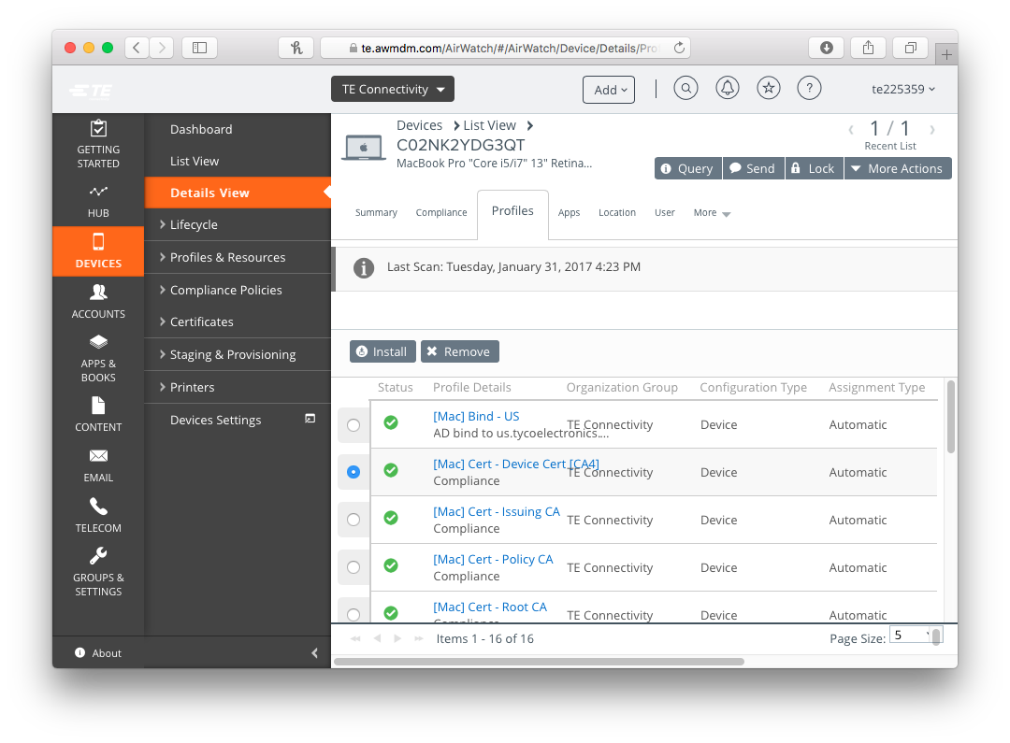
Profile Installation
You can verify that the new profile has been successfully installed on the device by changing back to the profiles section of that device record.
It may take several minutes for the device to receive the new profile. During this time, the checkmark will be grey instead of green, just keep querying and refreshing this screen until the check turns green. If it instead displays a red X or yellow exclamation mark, the profile has not installed and more targeted troubleshooting will be needed.

Slide 20
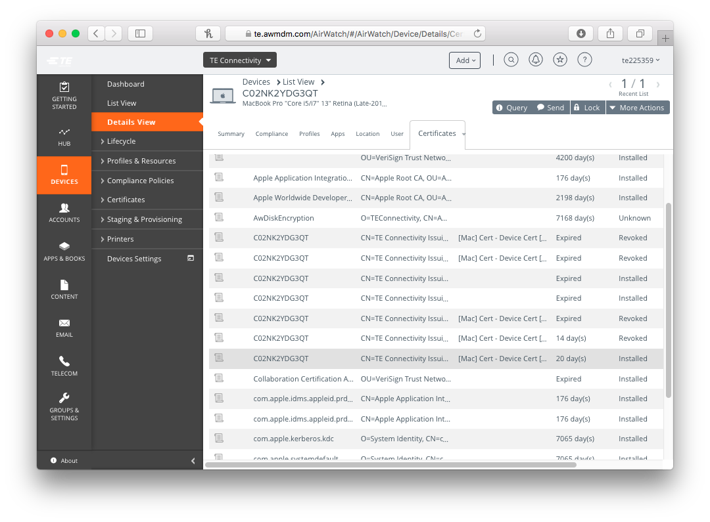
New Certificate Issued
Shortly after the new profile is deployed, a new device certificate should be issued. You can confirm this using the certificates section of the device record.
A new certificate issued with an expiration of “42 days” and a state of “Installed” should now be present.

Slide 21
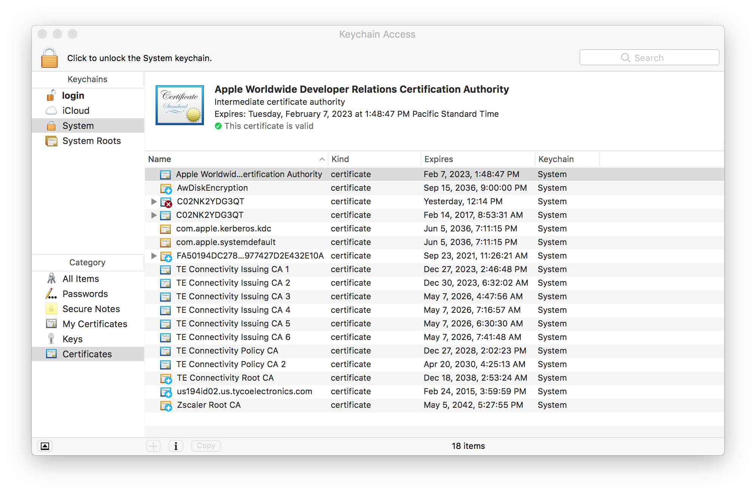
Final Confirmation
A new certificate, with the same name as the device’s serial number, should also be visible in Keychain Access.

Slide 22
Conclusion
Please be sure to include screenshots or exact text of any errors, either on the client or the AirWatch Admin Console, in the case notes.
If the above process does not result in a new certificate being issued, please contact me separately, as interactive troubleshooting will likely be required.
This process is only applicable to macOS Sierra devices that have been enrolled in AirWatch through running TEMPO. Devices that do not meet these requirements may be experiencing other issues outside of what this process outlines.

